Slide 1
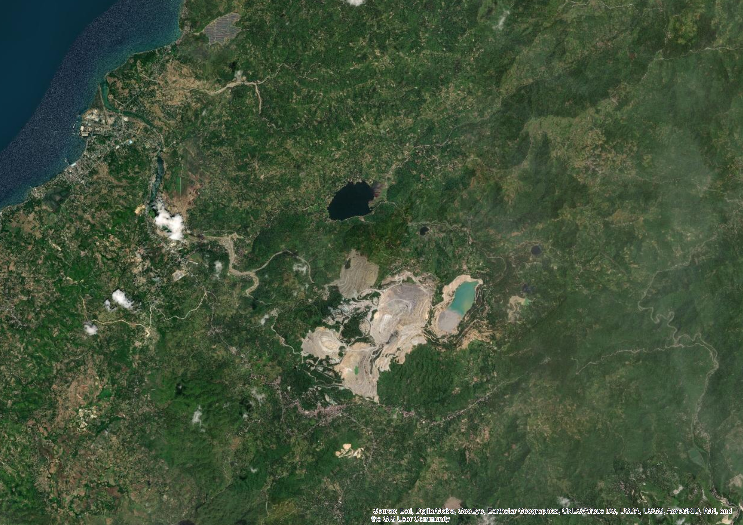


Restoring The Big River
Esri (2020)
ENS 236
Restoration Ecology
A proposed restoration plan for Sapangdaku River in Toledo City
that has been threatened by Climate Change, Sand & Gravel Quarrying and Urbanization
Presented by:
Mark A. Cabanlit & Rhee S. Telen
Notes:
Image Source:
Esri, DigitalGlobe, GeoEye, i-cubed, USDA FSA, USGS, AEX, Getmapping, Aerogrid, IGN, IGP, swisstopo, and the GIS User Community. (2020). World Basemap Imagery. Esri. Cebu: Esri.

Slide 2
Contents
Rationale
2. Site Description
3. Objectives
4. Strategies & Reference Site
5. Action Plan
6. Timeframe
7. Financing & Budget
8. Monitoring Plan
9. Potential Problems
10. Risks & Uncertainties
11. Assumptions
(Esri, DigitalGlobe, GeoEye, i-cubed, USDA FSA, USGS, AEX, Getmapping, Aerogrid, IGN, IGP, swisstopo, and the GIS User Community, 2020)
12. Conclusion
Notes:
Image Source:
Esri, DigitalGlobe, GeoEye, i-cubed, USDA FSA, USGS, AEX, Getmapping, Aerogrid, IGN, IGP, swisstopo, and the GIS User Community. (2020). World Basemap Imagery. Esri. Cebu: Esri.

Slide 3
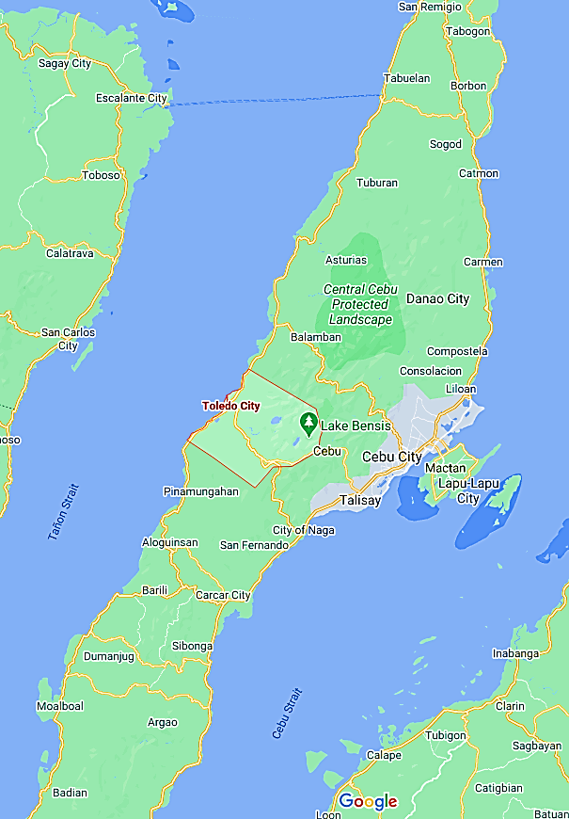
Rationale
Google Maps (2020)
Toledo City is the only city in Cebu Province that is situated on the Western seaboard facing Negros Oriental, while the remaining cities are in the East (Danao, Mandaue, Lapu Lapu, Cebu, Talisay, Naga and Carcar, and on the North and Easter side (Bogo).
Toledo City produces:Copper, gold, silver, red burning clay, marble, cement raw materials, bentonite, limestone, marbleized limestone, sand, gravel, coconuts and buri, pandan leaves, nito stalks, rice stalks, buri palms, seedlings, etc.

Slide 4
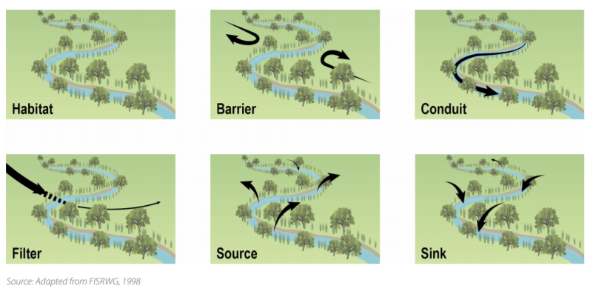
Why Restore?
River restoration is the re-establishment of natural physical processes, feature and physical habitats of a river system.
River ecosystems perform a number of critical ecosystem functions.
These functions can rely on any and all of the various parts that make up a river ecosystem.
(World Wide Fund for Nature (WWF), General Institute of Water Resources and Hydropower Planning and Design (GIWP), & UNESCO, 2016)
Notes:
https://smartnet.niua.org/sites/default/files/resources/245644e.pdf
River restoration is the re-establishment of natural physical processes (e.g. variation of flow and sediment movement), features (e.g. sediment sizes and river shape) and physical habitats of a river system (including submerged, bank and floodplain areas).

Slide 5
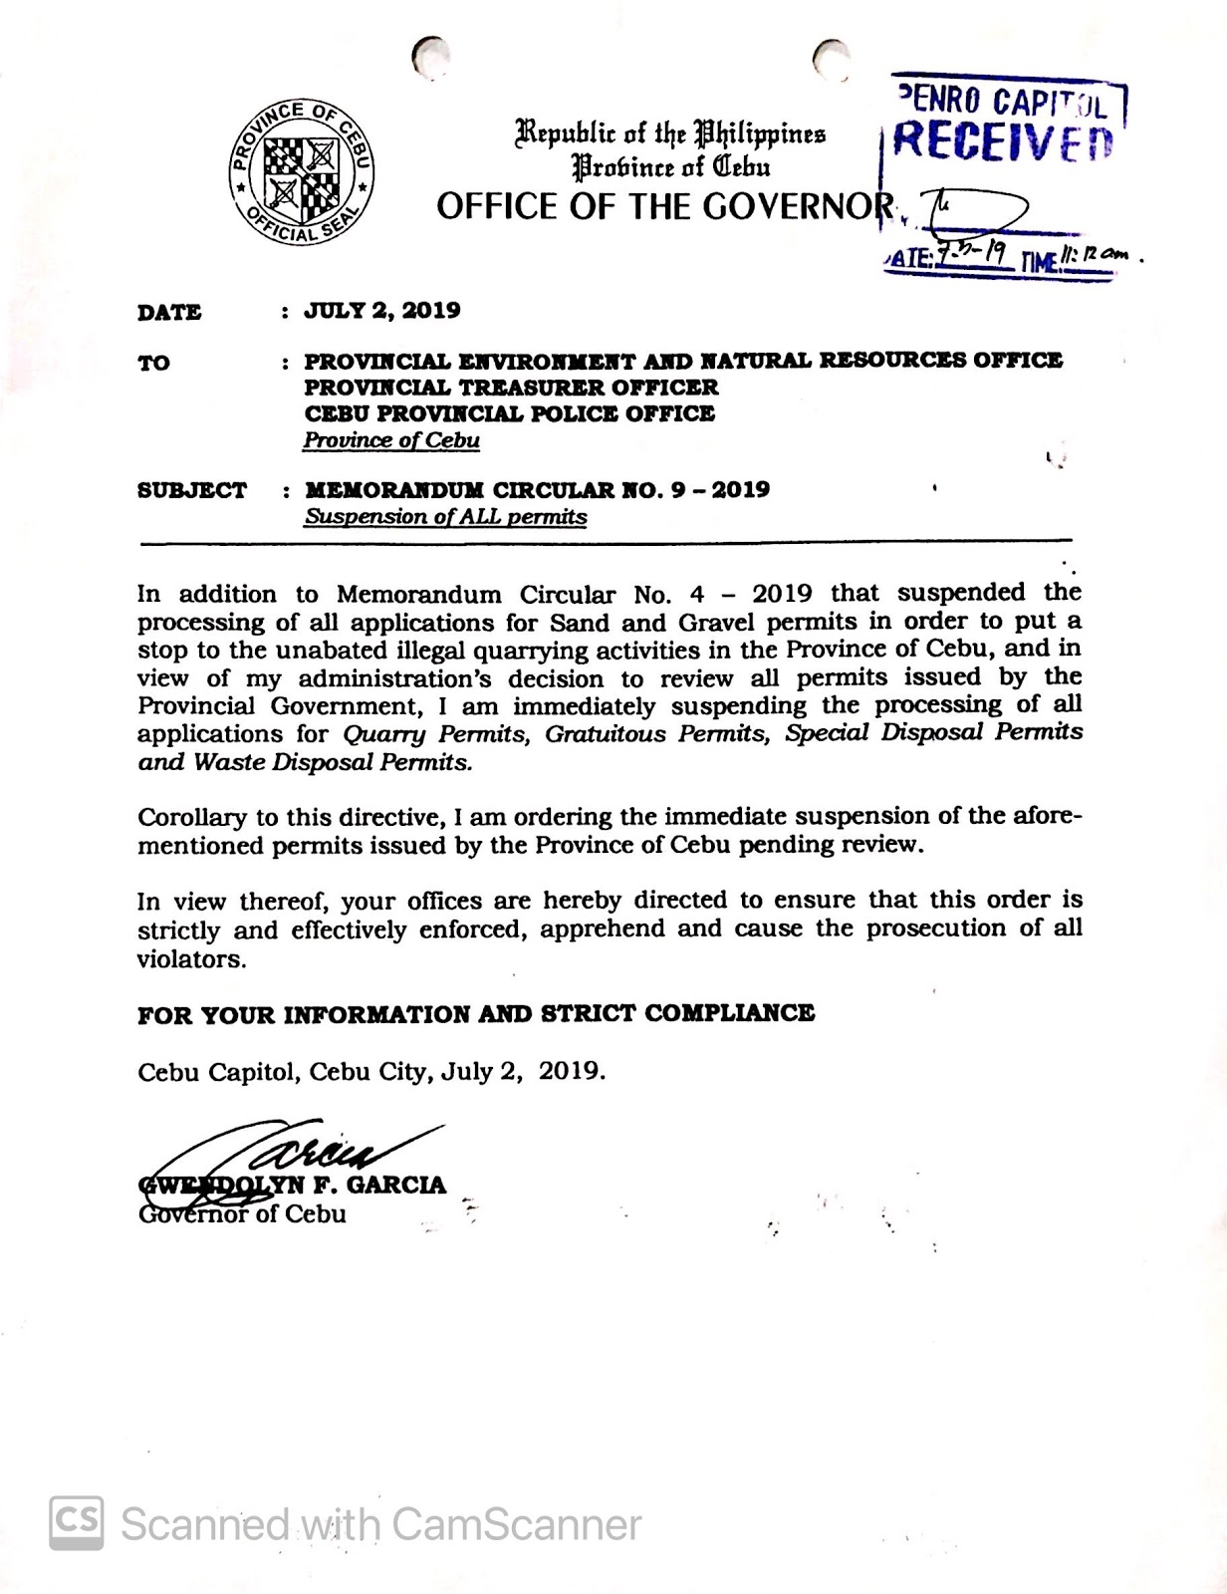
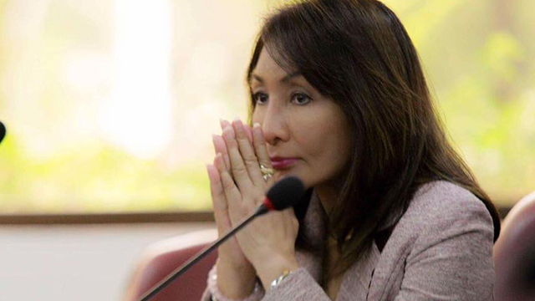
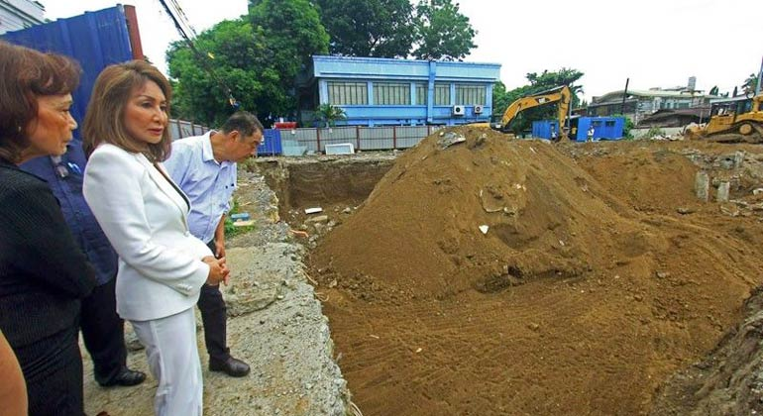
Why Restore Now?
A ban on sand and gravel quarrying has been implemented in the province of Cebu as of July last year through the issuance of Memorandum Circular 4 and 9 S 2019.
The reason for the implementation of the ban may not be entirely of ecological reason but rather of political and financial gains.
However, due to the climate crisis that the planet is experiencing, we must act now before it’s too late.
Cupin, 2018
The Freeman, 2019
Notes:
https://www.bworldonline.com/new-cebu-governor-orders-halt-to-all-quarrying-provincial-engineers-projects-and-p1-3b-capitol-building/
https://www.google.com/url?sa=i&url=https%3A%2F%2Fwww.rappler.com%2Fnewsbreak%2Fin-depth%2Fgwen-garcia-controversy-balili-property-cebu&psig=AOvVaw0-xJZRNRBA9h5uJT-yoBOd&ust=1607290135316000&source=images&cd=vfe&ved=0CAIQjRxqFwoTCKiawsXkt-0CFQAAAAAdAAAAABAE

Slide 6
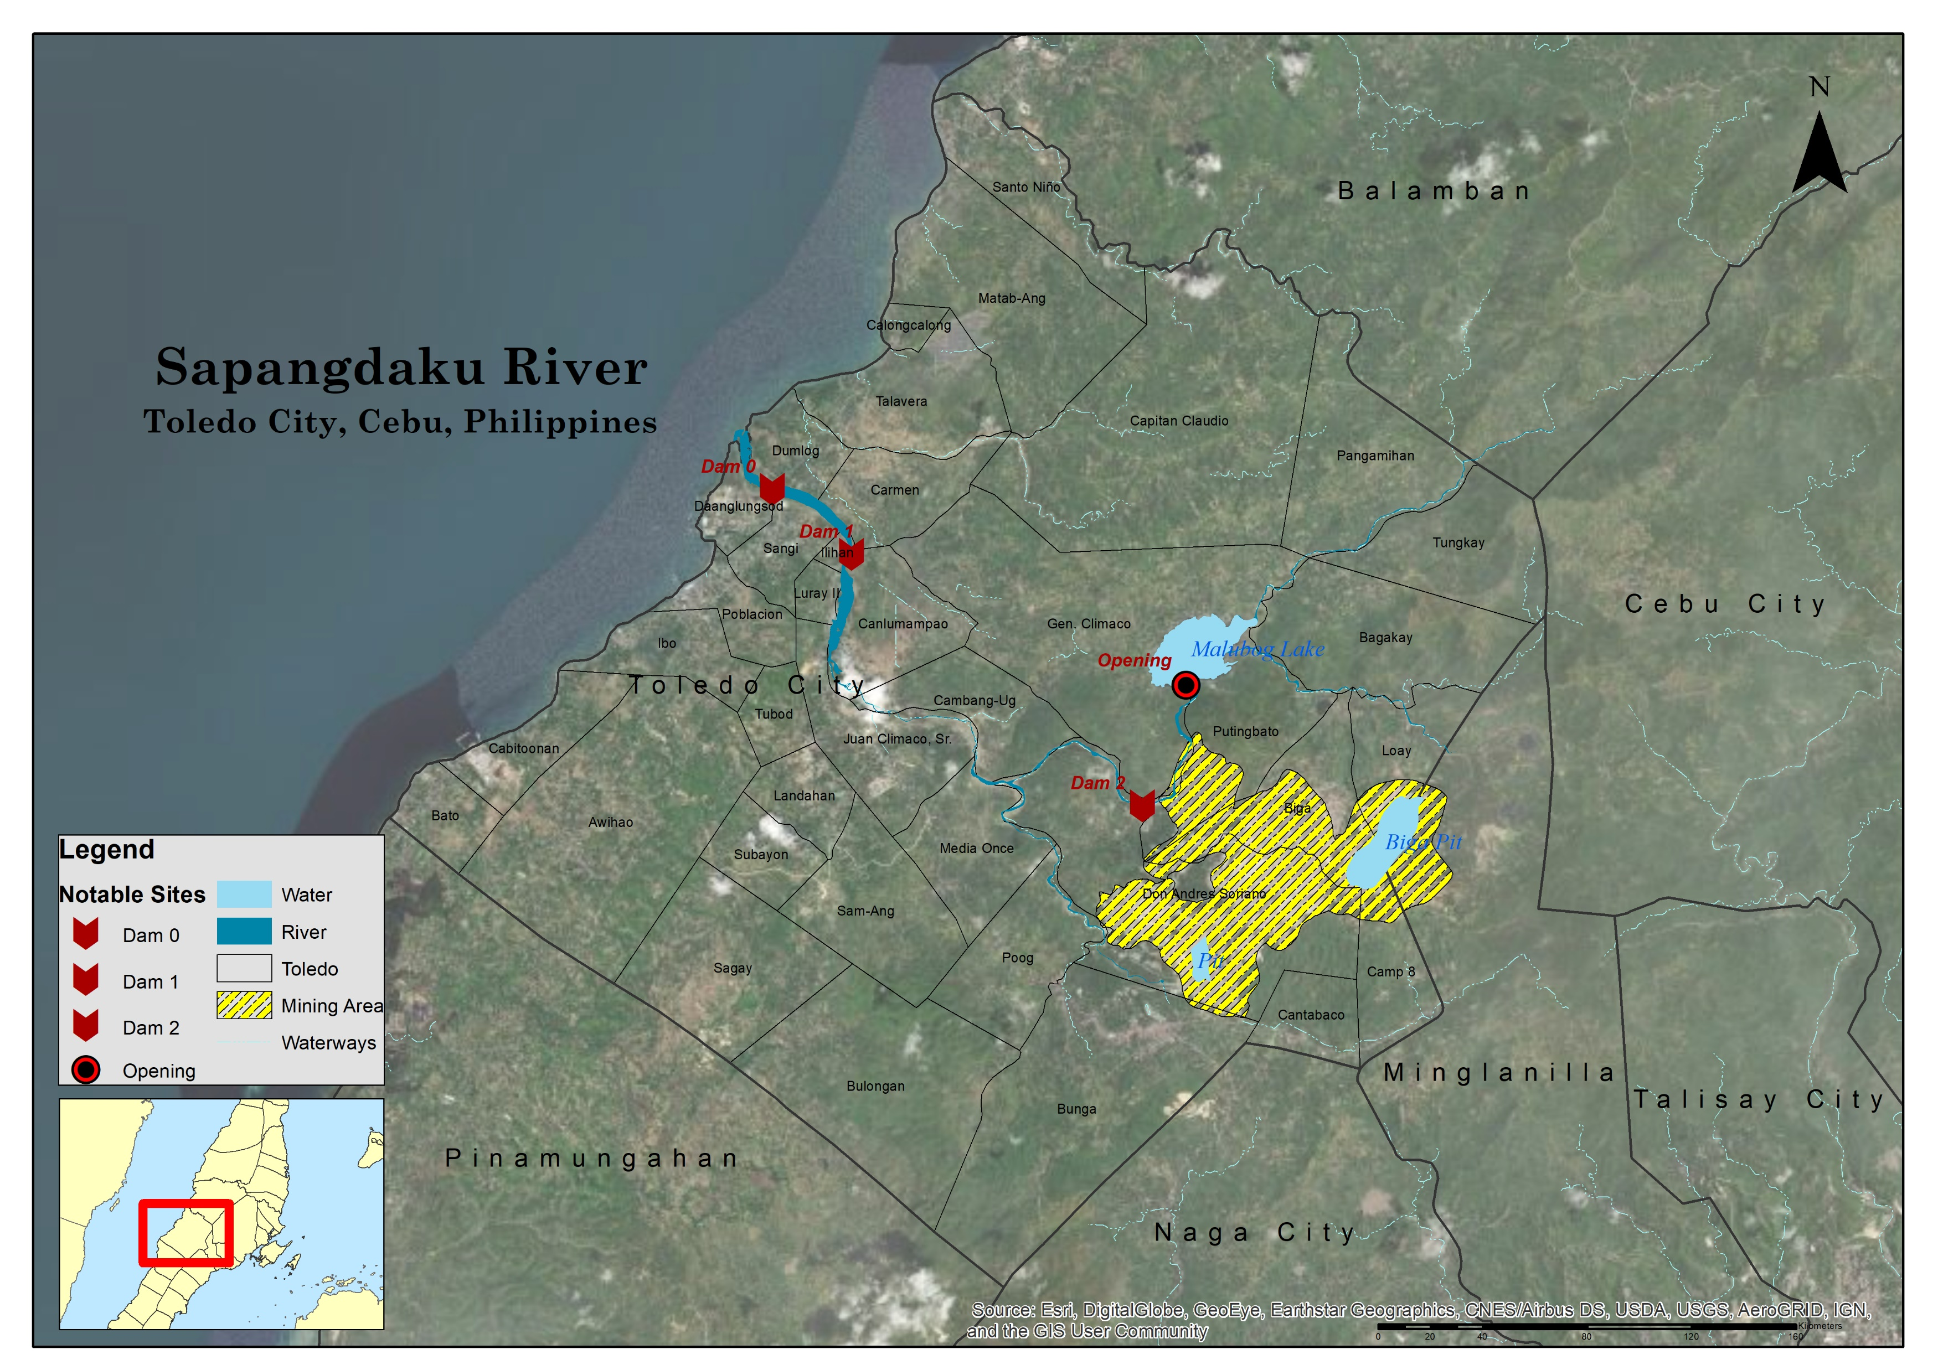
Rationale
Site
The river cuts across at least 7 Barangays of the city. Within these barangays, there were around 7 Sand and Quarry extraction site within the river systems.
At least 2 gabion dams were also constructed to prevent siltation to reach the marine waters.
Toledo City is the only city in Cebu Province that is situated on the Western seaboard facing Negros Oriental, while the remaining cities are in the East (Danao, Mandaue, Lapu Lapu, Cebu, Talisay, Naga and Carcar, and on the North and Easter side (Bogo).
Toledo City produces:Copper, gold, silver, red burning clay, marble, cement raw materials, bentonite, limestone, marbleized limestone, sand, gravel, coconuts and buri, pandan leaves, nito stalks, rice stalks, buri palms, seedlings, etc.

Slide 7
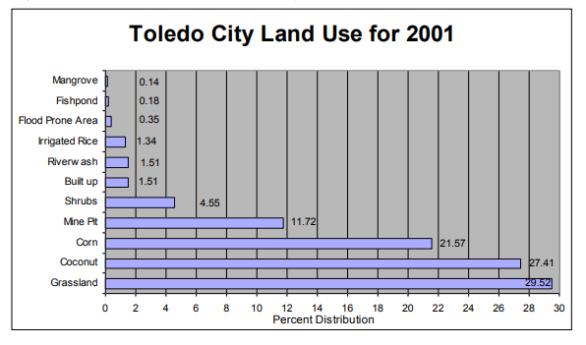
Land Use
Population is highest in the coastal barangays where most of the barangays are located. About one fourth of the total population is located in the six mining host barangays. The five upland barangays have the least population.
Approximately 80 % of the total land area of Toledo City is classified as alienable and disposable (A&D) lands and the remaining 20%, timberland.
Environmental Science for Social Change, 2008
Notes:
https://essc.org.ph/content/wp-content/uploads/2011/05/lmv_cebu.pdf

Slide 8
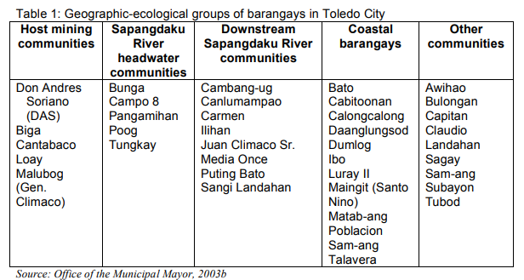
Toledo City
Toledo City has a total land area of 17,400 hectares subdivided into 38 barangays, classified into five groups based on their geographical location in relation to Atlas mining impact.
Barangay | Population
Dumlog | 5288
Daanlungsod | 2933
Sangi | 4201
Carmen | 3858
Canlumampao | 4170
Ilihan | 3206
Magdugo | 6279
Total | 29935
Environmental Science for Social Change, 2008

Slide 9
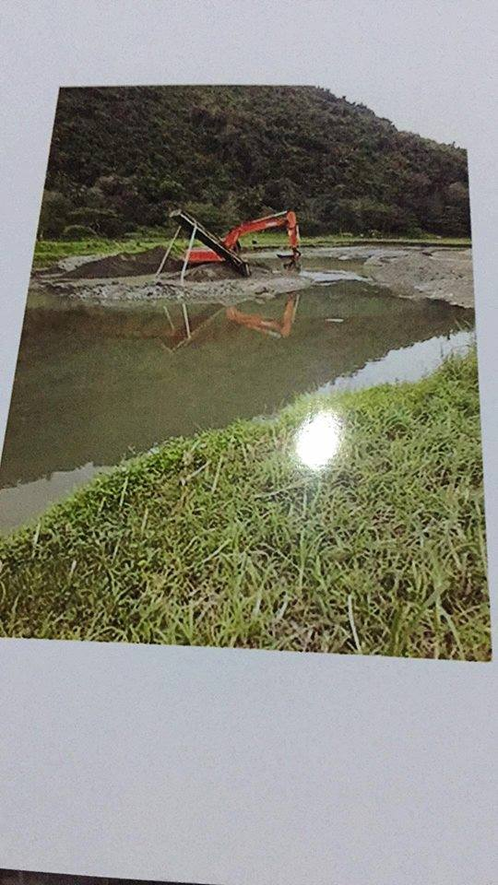
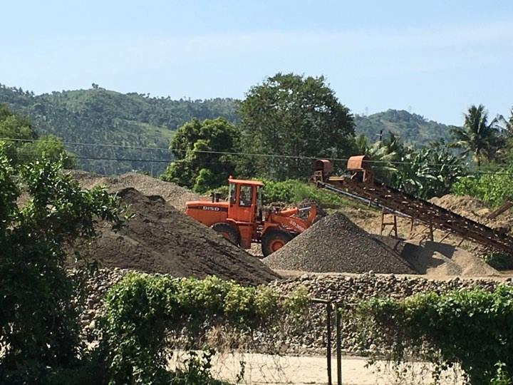
Threats
Extraction of Sand and Gravel, Removal of vegetation, creation of Pavements, roadways due to heavy equipment crossing within riparian zones, creating fragmentation.
Contamination of water and sediments; severe erosion and mass wasting processes in unstable landforms (pits, stockpiles, waste dumps);
Sediments coming from pits undergoing severe erosion that are washed into the creeks and rivers do not only worsen siltation in streams. These are also contaminated, thus re-contaminating the streams and when carried downstream, transport pollutants offsite.
Environmental Science for Social Change, 2008
Save Hinulawan River, 2018

Slide 10
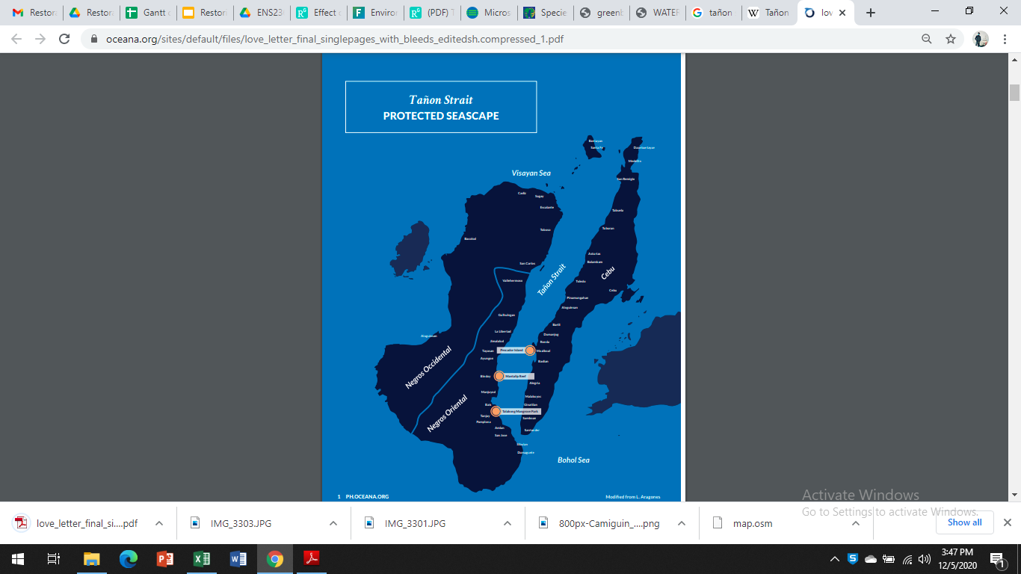
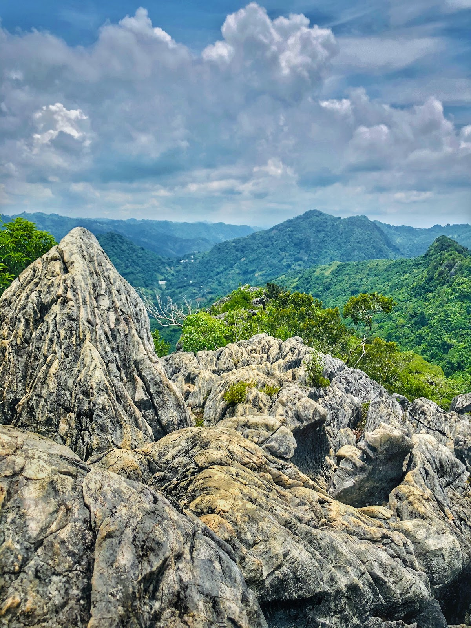
Importance
Connects 2 Protected landscapes
In the ridge, Hinulawan river’s tributary stream and creeks are connected to the Central Cebu Protected landscape. CCPL is one of the few protected landscapes in the Province which aims to conserve and preserve Native flora and fauna species at risk to extinction
Downstream, Hinulawan River is connected to Tanon Strait which is declared as a Protected Seascape since 1998. This is the largest marine protected area in the Philippines, home of 14 species of whales and dolphins which live within this special place.

Slide 11
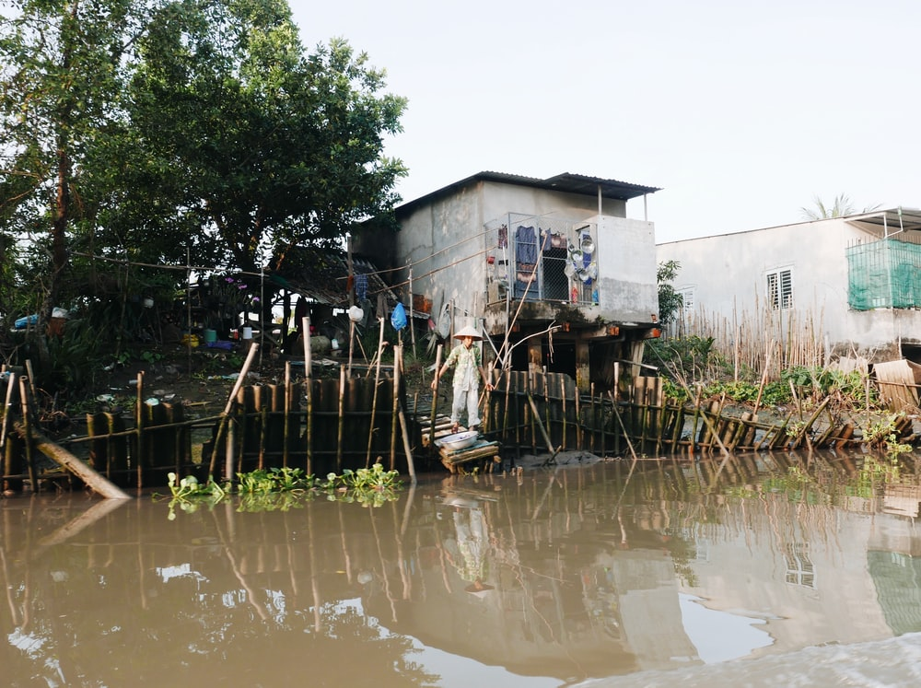
History
Based on an interview with Architect Ahmed Lebumfacil, the administrator of the Save Hinulawan River Group:
Years back, they can still catch danggit upstream.
The mouth of the river was teeming with wild ducks
A lot of these plants were still present: Nauclea orientalis and Pithecellobium dulce
The recent floods occured in Sapangdako river were on December 2015 (Typhoon Seniang) and December 2017 (Typhoon Nona). These said inundation incident caused to displace thousands of families living in beside the said river system, damages to residential and agricultural areas.
Photo by Falco Negenman on Unsplash
Notes:
Image Source: https://unsplash.com/photos/O9uwdPbxroc

Slide 12
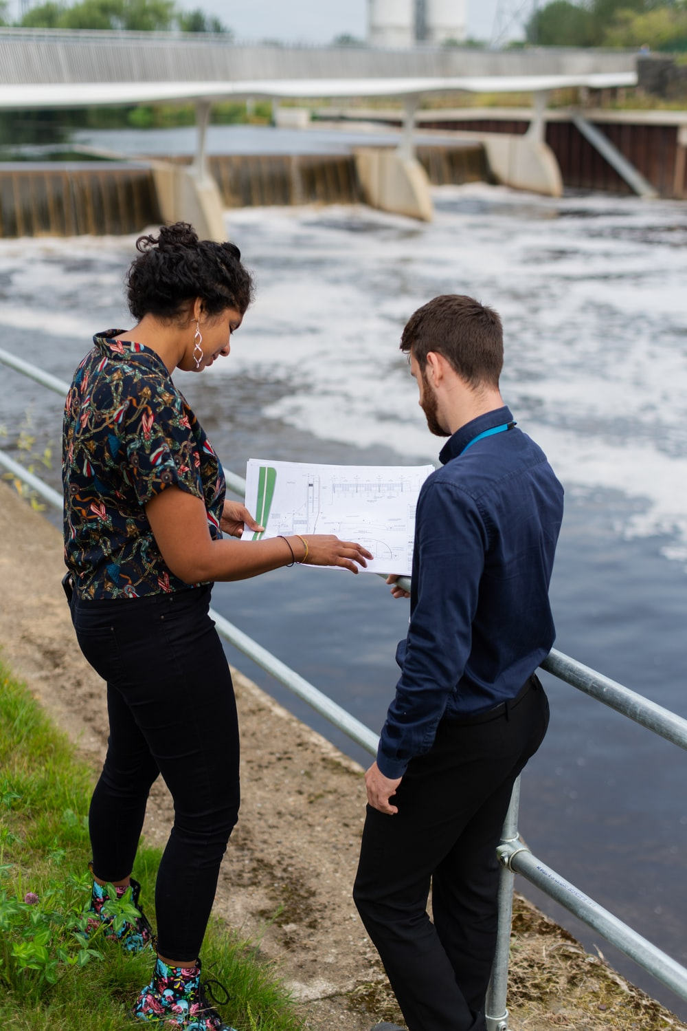
Goals
Photo by ThisisEngineering RAEng on Unsplash
Ecological Goal (Phase I)
To reestablish :
Natural physical processes such as variation of flow and sediment movement.
Features such as sediment sizes and river shape
Physical habitats of a river system including submerged, bank and floodplain areas.
Holistic Goal (All Phases)
To promote wellness for the citizens of Toledo City living within the river by restoring their river and its ecological functions and to develop environmental consciousness leading towards a community-managed and sustainable river protection effort.
Notes:
Image Siource: https://unsplash.com/photos/oqQu7qjXWRk

Slide 13

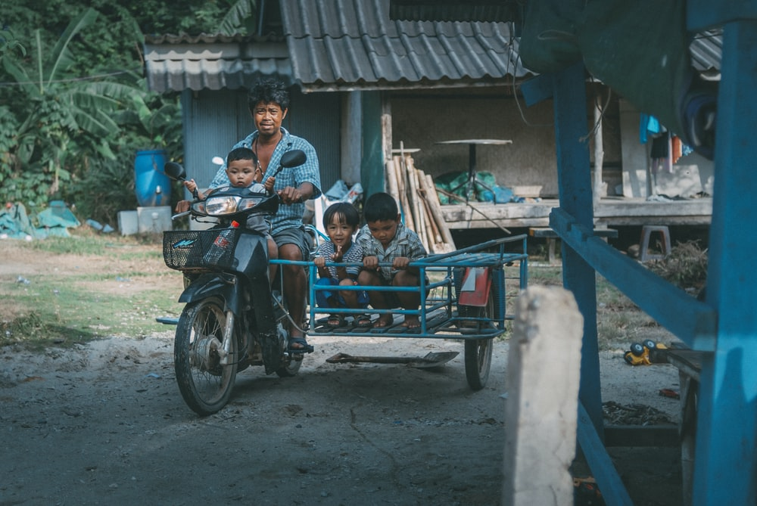
Objectives (Phase I-V)
I
To facilitate the redirection the water stream to its proper flow, allowing occasional rise of water as a natural disturbance in the flood plain without causing further damage to the communities nearby.
II
To analyze the feasibility of the structures and measures implemented in Phase I and check the flow from a control site without any current intervention as compared to the one test site in Phase I. If the results are optimal then proceed with replicating Phase I.
III
To analyze and model the flow of the river now that the physical modifications have been made and to check and improve water quality .
IV
V
To reintroduce historical species on the site such as Nauclea orientalis, Pithecellobium dulce & Siganus canaliculatus and to plant and reforest nearby forests to have stronger banks to prevent landslides.
To employ sustainability in the restoration through institutionalization, educational partnerships, and to provide sustainable ecotoursim opportunities.
Photo by Charlein Gracia on Unsplash
Photo by Egor Myznik on Unsplash
Notes:
https://unsplash.com/photos/dDrQPSbYQRk
https://unsplash.com/photos/2xRqmqJJfZY

Slide 14
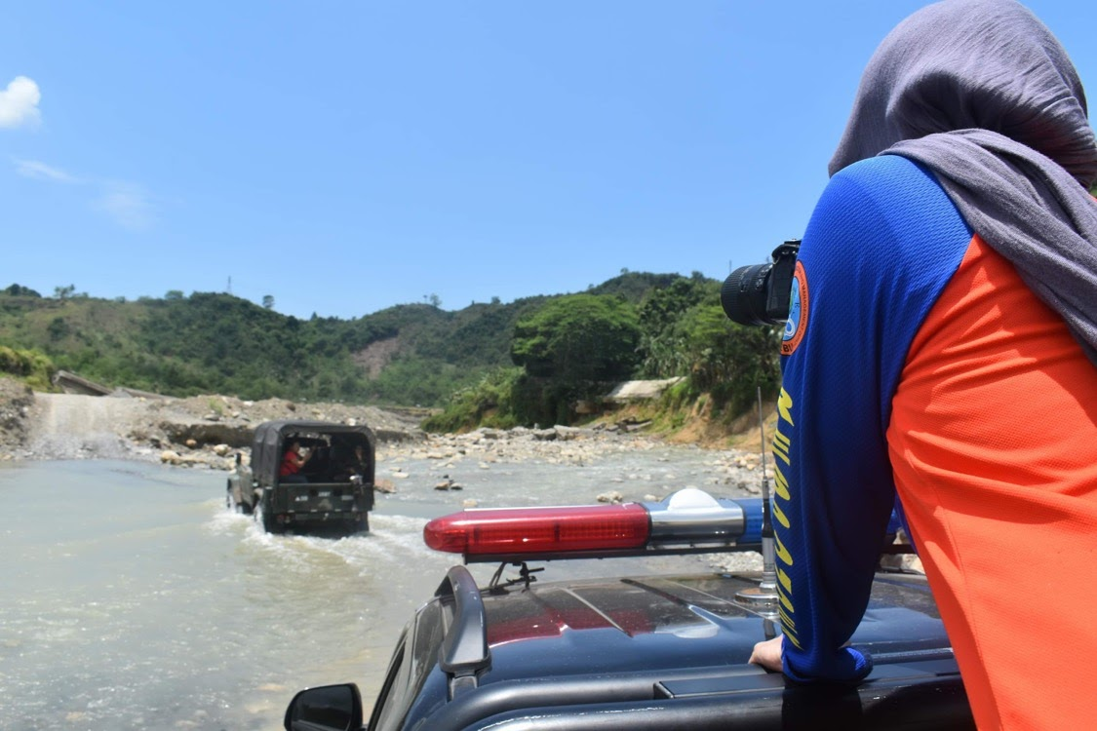
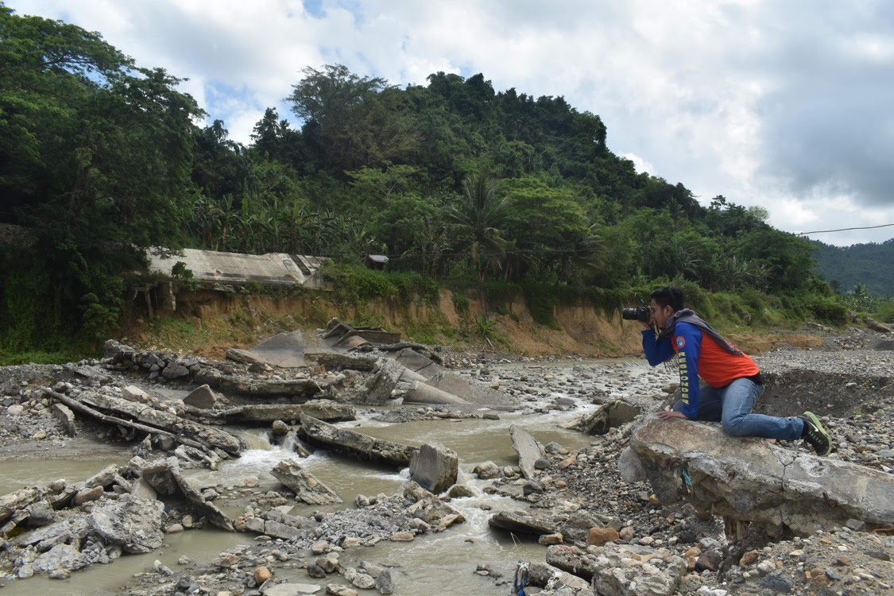
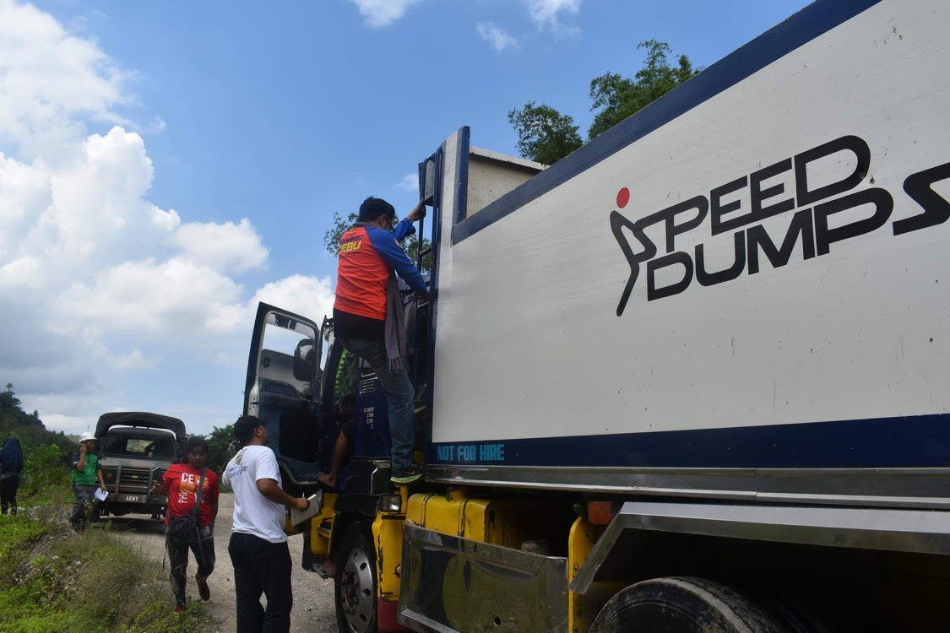
General Strategies
& the Reference Site
Due to the extent of the damaged caused by sand and gravel extraction, construction of structures and other urban developments, the whole restoration project is subdivided into 5 different phases of action.
Each phase contains specific spatial and temporal set of objectives encompassing the river’s physical, geological, chemical attributes as well as its biotic factors expected to be done in a span of 10 years.
But for this specific restoration, the restorers will only deal with the 1st phase (the physical attributes) which is scheduled to be completed in the next 3 years (2021-2024).

Slide 15
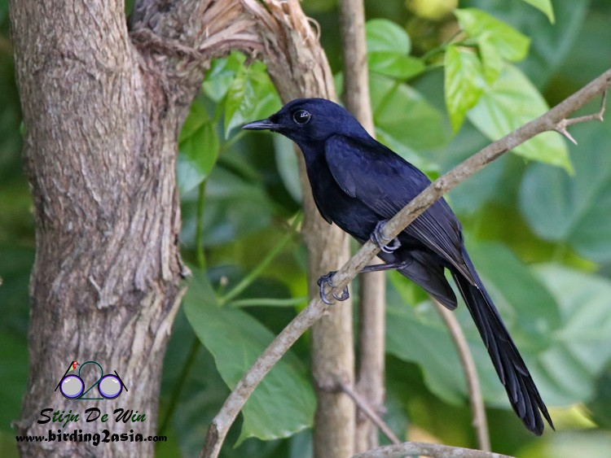
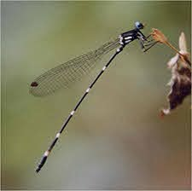
Reference Site
The restorers used the upland portion of the rivers (Ilag and Hinulawan tributary rivers) as the reference site.
Also, researches of other rivers in Cebu, such as the Badian river were also used to compare the status of the Hinulawan River as one of our measurement of success.
Badian River holds population of threatened endemic species including the endemic and restricted-rage, namely; Cebu Frill-wing, Black Shama, Cebu Hawk-owl, and Tube-nosed Fruit Bat. In 2016 the wildlife observed in the river can be classified into fifteen (15) groups of wildlife. A notable number of species came from Class Aves (26 species), Order Lepideptera (17 species), Class Gastropoda (16 species) and Order Odonata (10 species).
Notes:
https://ebird.org/species/blasha1
https://www.angelfire.com/empire/usc_brg/spec_disc.htm

Slide 16
Action Plan
Phase I
River Restoration Measure | Active Restoration | Passive Restoration | Responsible Entity | Output | Outcome
Catchment management | Earthworks to create natural levees Massive plantation of different native plant and tree species to protect the river banks Selective construction of concrete flood control infrastructures to the densely populated areas near riverside | Revise and Improve Development plans of the City Government (CLUP, FLUP DRRM) Strict imposition of the Provincial Memorandum to stop all forms of sand and gravel quarrying in the Rivers Constant implementation of Monitoring and evaluation including all stakeholders and community members | City Government, Barangay officials, residents, CSOs NGOs, Business Contractors formerly extracted sand and Gravel in the area | Number of Bamboos and Native Trees are planted within riverbanks of site 1 Length of river banks upheaved and strengthened | Reduction of soil erosion cases in the riverbanks of site 1 Elimination of all forms of sand and gravel quarrying in the pilot site
Flow modification | Delineate zones of the river (Stream, River Bank, Riparian zone etc.) Installation of water level measuring measurement (Indigenous/Manual and High-Tech specialized sensors) Conduct conservative dredging to specific sites of the river basin |  |  | Fully delineated river zones in Site 1 Length of riverbed dredged Number of water monitoring devices installed | Reduction of flooding cases in nearby settlements and agricultural area Increased capacity of the Community to prepare and respond to any inundation incidences

Slide 17
Phase II (Replication)
River Restoration Measure | Active Restoration (to 7 other extraction sites) | Passive Restoration | Responsible Entity | Output | Outcome
Catchment management | Earthworks to create natural levees Massive plantation of different native plant and tree species to protect the river banks Selective construction of concrete flood control infrastructures to the densely populated areas near riverside | Modify the restoration activities based on the learnings from Phase I | City Government, Barangay officials, residents, CSOs NGOs, Business Contractors formerly extracted sand and Gravel in the area | Number of Bamboos and Native Trees are planted within riverbanks of other 7 sites Length of river banks upheaved and strengthened | Reduction of soil erosion cases in the riverbanks to other 7 sites Elimination of all forms of sand and gravel quarrying in the pilot site
Flow modification | Delineate zones of the river (Stream, River Bank, Riparian zone etc.) Installation of water level measuring measurement (Indigenous/Manual and High-Tech specialized sensors) Conduct conservative dredging to specific sites of the river basin |  |  | Fully delineated river zones in the other 7 sites Length of riverbed dredged Number of water monitoring devices installed | Reduction of flooding cases in nearby settlements and agricultural area Increased capacity of the Community to prepare and respond to any inundation incidences

Slide 18
Phase III (Water Quality)
Restoration Measure | Purpose | Active Restoration | Passive Restoration | Responsible Entity | Output | Outcome
Water Quality Management | Protect and improve water quality, including chemical composition, temperature, colifom count and presence of other particulates | Community drainage, sewerage and septage management Upland wetland restoration entrapment and collection of solid waste and regular monitoring for the presence of hazardous materials | Strict implementaion of the Watercode Adopt and localize water management policies from National Government and International Organizations | City Government, Barangay officials, residents, CSOs NGOs, Business Contractors formerly extracted sand and Gravel in the area | Percentage of communities with proper drainage and septage systems No of wetlands developed upstream | Water Quality Test Passed in several water quality assessments Absence of Solid waste and other particulates in the water

Slide 19
Phase IV (Biodiversity)
River Restoration Measure | Purpose | Active Restoration | Passive Restoration | Responsible Entity | Output | Outcome
Phase IV (Biodiversity - Reintroduction of Species) 2024 Onwards
Reintroduction of Flora and Fauna species | To reactivate the ecosystem function services provided by the river though species protection and management | Reintroduction of species such as danggit, wild ducks as well as the native flora such as Nauclea orientalis (Bangkal) and Pithecellobium dulce (Camachile) that were previously thriving in the river. | Management and control of species growth Establishment of Protected zones and No dwelling zones | City Government, Barangay officials, residents, CSOs NGOs | No of flora and fauna species reintroduced in the entire stretch of the river system | Increased species biodiversity and mean density presence of other terrestrial species benefiting from the river ecosystem

Slide 20
Phase V (Sustainability)
River Restoration Measure | Purpose | Active Restoration | Passive Restoration | Responsible Entity | Output | Outcome
Phase V (Socio-Cultural - Sustainability, Education and Eco-Tourism) 2024 Onwards
Sustainability, Education and Recreation | To ensure the sustainability of the project to the active engagement of community stakeholders as well as to become as a reference for other river restoration initiatives | Restocking of species And Redredging of riverbed Removal of concrete infrastructures if bioengineering initiaives took off efficiently | Constant monitoring and evaluation for regular assessment and adaptive management | City Government, Barangay officials, Community leaders and residents | Inventory of species present in the river system Levels of pollution, erosion and other river related incidences Maintained and accessible data of the entire river health, its features and processes | Increased number of researchers, tourists and excortions in the river Sustained Ecosystem funtion and stabilized structure without human intervention

Slide 21
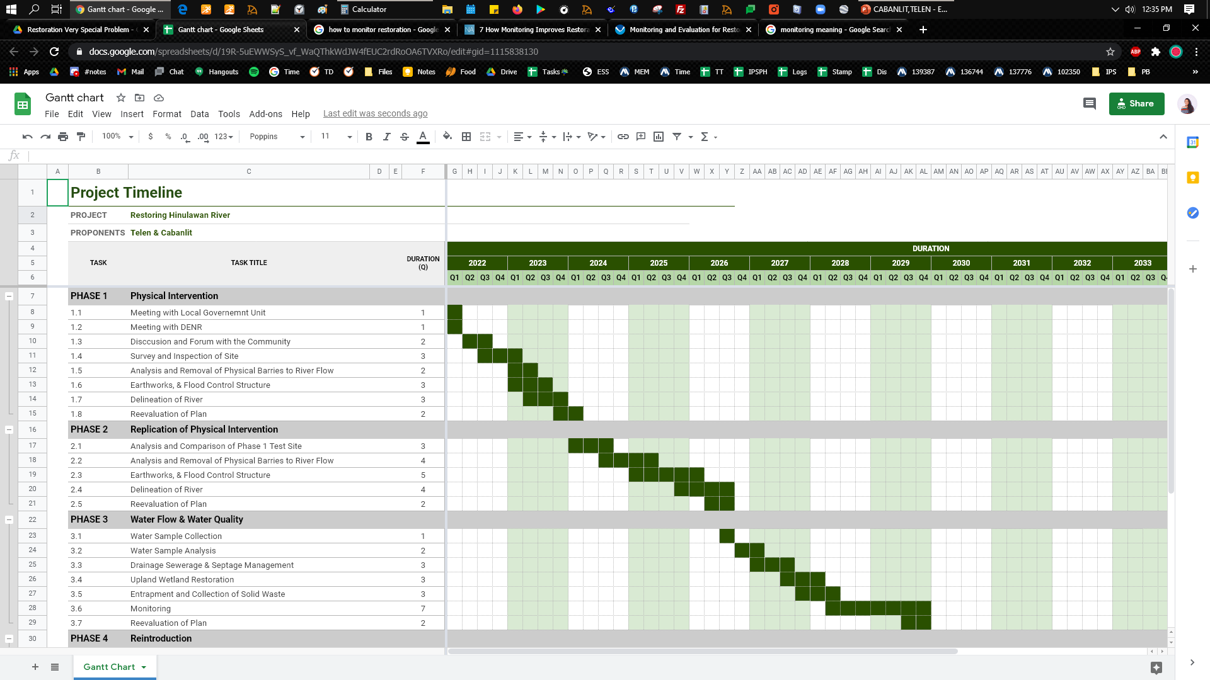
Phase | Duration
I | 2 years
II | 2 years and 9 months
III | 3 years and 6 months
IV | 6 years and 6 months
V | 2 years and 3 months
Total | 15 years
The plan is expected to run for 15 years with a reevaluation of goals, approach and targets for each phase in order to reassess if the project needs to adapt.
Timeline
Notes:
Can be edited here: https://docs.google.com/spreadsheets/d/19R-5uEWWSyS_vf_WaQThkWdJW4fEUC2rdRoOA6TVXRo/edit?usp=sharing

Slide 22
Financing & Budget Phase I
River Restoration Measure | Activities | Costs | Source | Sub-total
Catchment management | Rental of Heavy Equipment and Manpower | Free (Exploiters Pay) | Private Contractors Companies | P 1,000,000.00
 | Purchase of Seedlings | P 100,000.00 | Government NGA
 | Management of Nursery | P 100,000.00 | Government CLGU
 | Logistical needs during Planting activity | P 50,000.00 | CSOs, NGOs
 | Labor and Materials for Flood Protection infrastructure | P 750,000 | Government (Equipment shouldered by contractors, sand and gravel from dredging)
 | Honorarium for Monitoring Personnel | Free (Brgy Tanods) | Barangay LGU
Flow modification | Hiring of GIS Specialist | Free | Government CLGU | P 250,000.00
 | Rental of Heavy Equipment and Manpower | Free (Exploiters Pay) | Private Contractors Companies
 | Purchase of Water Level Measurement devices (Manual and Computerized) | P 200,000.00 | CSOs, NGOs
 | Logistical needs for community coordination, Meetings etc. | P 50,000.00 | CSOs, NGOs
TOTAL COST (Phase I) |  |  |  | P 1,250,000.00

Slide 23
Phase II-V 2024 Onwards
Element Of River Ecosystem | River Restoration Measure | Activities | Costs | Source | Sub-total
Replication | Catchment and Flow Modification | As stated in the action Plan. Subject to change depending on the result of the assessment in phase I | P 3,000,000.00 | Stakeholders | P 3,000,000.00
Water Quality | Water Quality Management |  | P 1,000,000.00 | Stakeholders | P 1,000,000.00
Biodiversity | Instream Species Management |  | P 1,000,000.00 | Stakeholders | P 1,000,000.00
Socio-Cultural | Sustainability, Eco-Tourism |  | P 500,000.00 | Stakeholders | P 500,000.00
TOTAL (PHASE II-V) |  |  |  |  | P 5,500,000.00
Local : Local Development Fund, Intelligence Fund, Local DRRM Fund
National Fund: Congressional Funds, People’s Survival Fund,
NGOs, iNGOs CSOs, Private and Business present in the Locality working for Environmental Protection
Green Climate Fund, Soil and Water Conservation Foundation, Justice Peace Integrity of Creations Ramon Aboitiz Foundation, Quarry Operators’ Free Services (Polluters and Exploiters Pay)

Slide 24
Monitoring Type | Scope | Details | Frequency | Responsible Entity
Baseline | Current River status before restoration | Define and characterize the physical, ecological and sociological conditions of the entire river stretch This will include the historical accounts of the river attributes as a basis for comparison | Before Restoration commences | Restoration Team, City Environment and Natural Resources Office
Activity | Activities projected in the Action Plan for Phase I as per scheduled | Check each restoration activity if done properly following the stipulated timeline (Delineation, Dredging, Planting, Installation of Equipments etc.) Activities can be altered, changed or impeded anytime or as deemed necessary based on the conducted assessment and monitoring | Monthly Monthly reports should be submitted to the Technical Working group for Process Assessment | Restoration Team, Hired contractors
Financial | Expenses and Cost-Effectiveness | Monitor the expenses incurred in each activities done Locate and Assess which specific activity expenses can be realligned, Increase or Decrease the expenses according to the current situation and needs Identify new partners and stakeholders who could provide free services in relation to the activities to be done for the restoration Prepare a cost-benefit analysis of the overall expenses incurred for the entire duration of the restoration (Phase-1) and serve it as a basis for the next phases of the restoration | Monthly (For Expenses) Quarterly (For resource Mobilization) Post Restoration Phase-1/Year 3 (for Cost-Benefit Analysis) | Restoration Team's Technical Working Group, Partner CSOs, NGOs, City Government
To facilitate the redirection the water stream to its proper flow, allowing occasional rise of water as a natural disturbance in the floodplain without causing further damage to the communities nearby.
Monitoring

Slide 25
Monitoring Type | Scope | Details | Frequency | Responsible Entity
Impact | Assessment of the Expected output and outcome | Monitor the Geo-Physical factors of the river system compared to the previous contemporary status Check the parameters such as length of riverbed dredged, length of riverbanks altered, Number of plants species planted and grown Monitor the possible negative impacts created by the earth movemeths in the coastal areas (nearby delta, esturane ecosystem, coral reef within the municipality) Monitor the Socio-Economic impacts of the ongoing river restoration (Has the restoration affected the livelihood of the residents? Has the restoration impeded their domestic uses of the river, were there property enrcrouchment and other disturbances created due to the Restoration?) | Quarterly Quarterly reports should be submitted to the Technical Working group for assessment and planning Post Restoration Phase-1/Year 3 Report will include the overall assessment of the project's output based on the project's Goals and Objectives | Restoration Team's Technical Working Group, Partner CSOs, NGOs, City Government
Surveillance | Other Factors affecting Restoration | Monitor other external events that are happening in the upstream and other River tributaries Monitor the possible resumption of Illegal quarrying activities may it be manual labor or small scale companies Monitor weather conditions as well Socio-Political dimensions that could hamper the implementation of the restoration efforts | Constant/Regular from beginning to end Surveillance reports could be included in the overall monthly reports | Restoration Team's Technical Working Group, Partner CSOs, NGOs, City Government, Barangay Officials and Community Residents

Slide 26
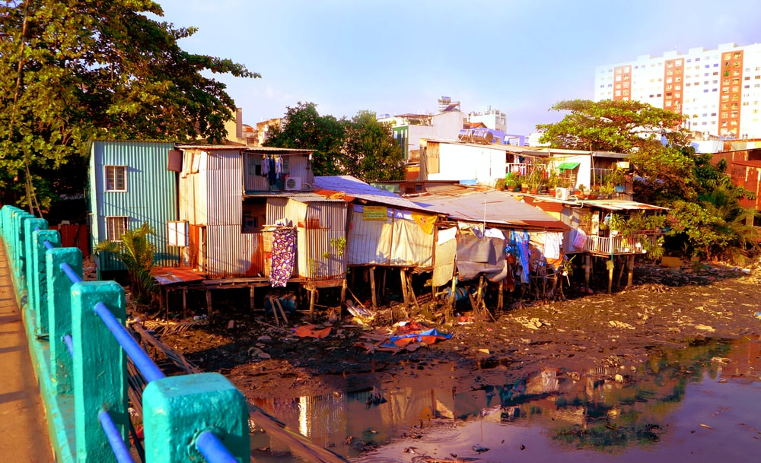
Potential Problems
Photo by Anh Vy on Unsplash
There are a few potential problems that may arise with the restoration plan however, the plan is divided into five phases with allotted timeframe for a reevaluation of the plan so that people involved can adapt and modify the plan if necessary. However here are a few potential problems that may arise:
Relocation of residents near the river if necessary.
Extreme unreported contamination from previous mining activities
Removal of sand & gravel quarrying ban after term
ExcessiveFlooding
Notes:
https://unsplash.com/photos/juET0JFrLGw

Slide 27
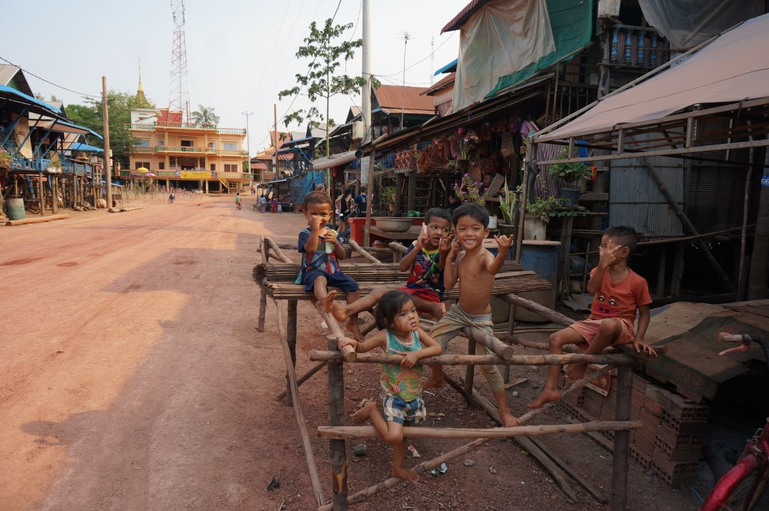
Risks and Uncertainties
Photo by Dylan Winterflood on Unsplash
There are always going to be risks and uncertainties in doing restoration.
Cost might be too much
Duration might be too long but there are studies that are even longer like the 79 years study about men by Harvard that has been well funded, we believe that this one is a much noble cause since it involves the lives of not just men but the whole ecosystem.
Effects of climate change such as the rising of the sea level
Change in policies or unfavorable action from elected officials.
Notes:
https://unsplash.com/photos/kmJ4DO30WPo

Slide 28
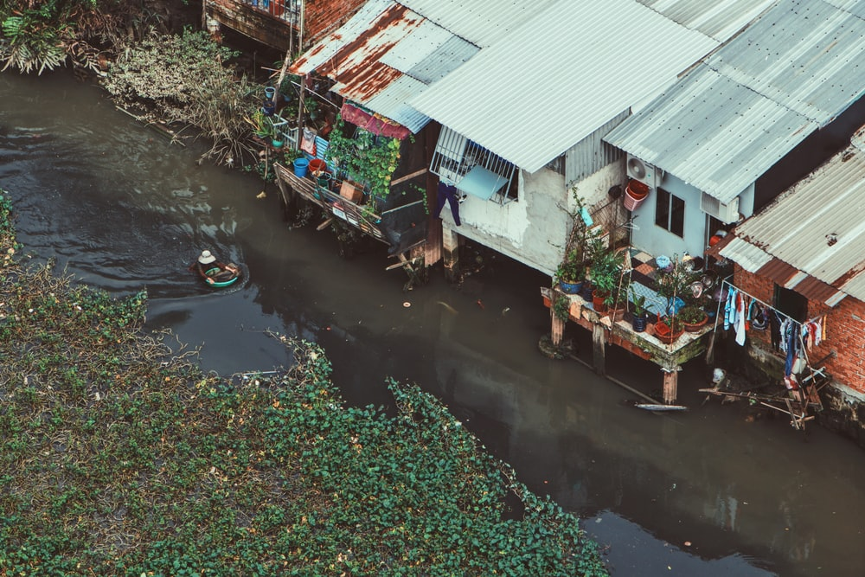
Assumptions & Dependencies
Photo by Tony Lam Hoang on Unsplash
That the proposed budget will be approved
The proposal does not take into account the possible externalities caused by copper mining.
The mill tailings are deposited to the Biga Pit Tailings Storage Facility (TSF), which continues to prove as a strong, safe, and secure facility for the mine. Overflow of excess water due to build-up of tailings mass is being channeled through a decant tower which passes through a series of sedimentation ponds before flowing into a combination of subterranean and above-ground pipelines discharging towards Hinulawan River and ultimately into the Sigpit Creek.
The water discharge permit was issued by the Department of Environment and Natural Resources in 2012. The water at Biga Pit has a PH level of 7.5 to 8 with fish species like tilapia thriving within. There are no reported storage leaks or containment breach at the Biga Pit TSF .
Notes:
https://unsplash.com/photos/fAYHQEopGPA

Slide 29
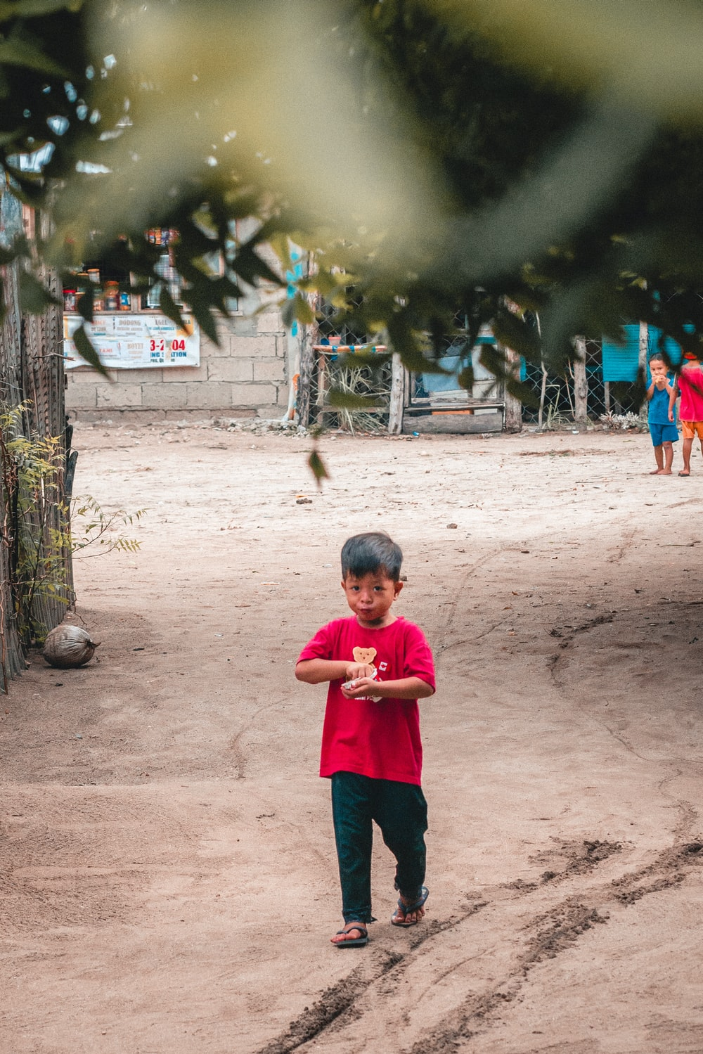
Conclusion
Photo by Austin Nicomedez on Unsplash
Sapangdako of Toledo city is considered one of the major river system in the Province of Cebu. With its length, Sapangdako plays a very important role in the maintenance of biodiversity as well as in providing different services to the communities surrounding it.
Despite the fact that the said river connects 2 Biggest protected areas in the country (CCPL and TSPS), rampant, excessive and ubiquitous exploitation has been done in the entire stretch of the river which started couple of decades ago.
With the Implementation of Memo Circulars 4 and 9 of 2019 of the Cebu Provincial Government - Stopping all sand and gravel extraction in the entire Province plus the suspension of all extraction permits, it is considered timely that all stakeholders to take action to protect and restore the previous pristine status of the river - home of danggit, wild ducks, and several endemic trees and other species native in Cebu and the Philippines.
As Sapangdako river stretches around 9.36KM paired with intense degradation due to the over and illegal extracion of Sand and Gravel, the Restoration Program is then divided into 5 Phases encompassing the aspects of Geophysical, Water Quality, Biodiversity and Sustainability, each with specific Goals, objective and specific activities to be done. Restoration Team will take the program step by step following the proposed phases. Each Phase is specially designed to undergo a full assessment and monitoring which will become the basis of the implementation of Phases II to V.
WIth the support of all stakeholders, considering all the risks and assumptions in the implementation of the program, this restoration effort will serve as the learning hub for a holistic, sustainable and long term initiative for the protection and management of river systems.
Notes:
https://unsplash.com/photos/Esb5zraCHs0

Slide 30


References
Photo by Bryn Parish on Unsplash
Cupin, B. (2018, February 16). Gwen Garcia and the Balili property: A tale of two controversies. Retrieved from Rappler: https://www.rappler.com/newsbreak/in-depth/gwen-garcia-controversy-balili-property-cebu
Environmental Science for Social Change. (2008). Legacy Mines Visit. Retrieved from Atlas Consolidated Mining Development Corporation Toledo City, Cebu Environmental and Comunity Impact: https://essc.org.ph/content/wp-content/uploads/2011/05/lmv_cebu.pdf
Esri, DigitalGlobe, GeoEye, i-cubed, USDA FSA, USGS, AEX, Getmapping, Aerogrid, IGN, IGP, swisstopo, and the GIS User Community. (2020). World Basemap Imagery. Esri. Cebu: Esri.
Miller, A. I. (2020, February 7). 9 Amazing Attractions in Toledo City | Sugbo.ph - Cebu. Retrieved from Sugbo.ph: https://sugbo.ph/2020/attractions-in-toledo-city/
Save Hinulawan River. (2018, March 29). Save Hinulawan River. Retrieved from Facebook: https://www.facebook.com/pg/SaveHinulawanRiver/photos
The Freeman. (2019, July 2). CEBU Governor Gwendolyn F. Garcia (in white) at the site of the P1.3 billion Capitol Resource Center project. Retrieved from BusinessWorld: https://www.bworldonline.com/new-cebu-governor-orders-halt-to-all-quarrying-provincial-engineers-projects-and-p1-3b-capitol-building/
World Wide Fund for Nature (WWF), General Institute of Water Resources and Hydropower Planning and Design (GIWP), & UNESCO. (2016). River Restoration: A Strategic Approach to Planning and Management. Paris, France. doi:ISBN 975-92-3-100165-9
Thank you!
Notes:
Photo by Bryn Parish on Unsplash (February 15, 2018)

